Slide 1

R Shiny: Bug hunting
Logging, error handling and post-mortem analysis
Feb 15, 2023 by J. A. (last updated Feb 24, 2023)
License: GPL3 (https://www.gnu.org/licenses/gpl-3.0.en.html)
Source and author see: https://github.com/aryoda/R_shiny_post_mortem_analysis_training

Slide 2
What’s the problem?
Have you ever tried to
find out why your shiny app does not show correct results?
find the reason of an error or warning in your code?
fix a bug that happens only in your production system (shiny server) but not on your DEV computer?
fix a bug that does occur only randomly (= is not reproducible)?

Slide 3
Ways to solve the bug hunting challenge...
Use the CRAN package tryCatchLog + a supported logging package and learn how to do
logging
error handling → only required parts using “tryCatchLog” to enable logging and post-mortem dumps are covered here
debugging in RStudio → out of scope here (belongs to the “basics”)
post-mortem analysis (using dump files)

Slide 4
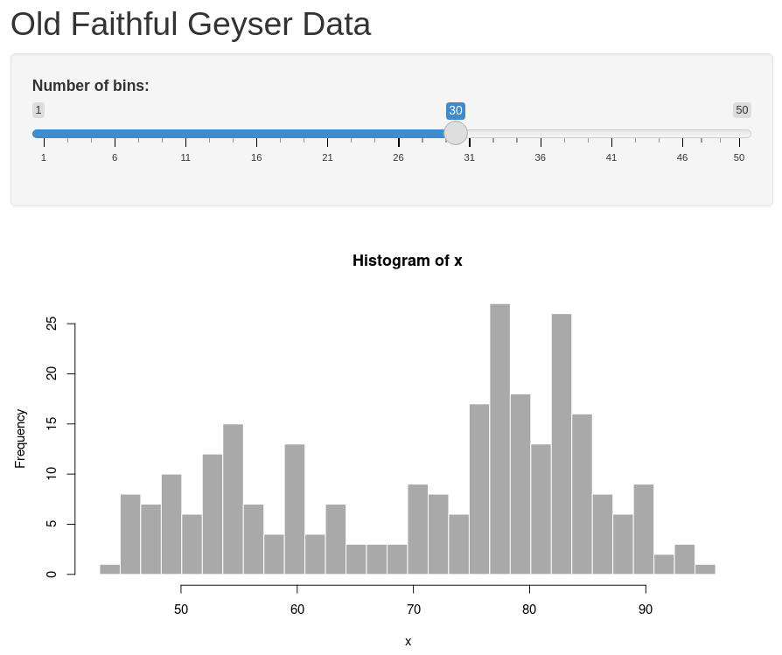
Let’s play with this “hello world” shiny app...

Slide 5
1) “Hello world” shiny app with code*
library(shiny)
ui <- fluidPage(
titlePanel("Old Faithful Geyser Data"),
sidebarLayout(
sidebarPanel(
sliderInput("bins",
"Number of bins:",
min = 1, max = 50, value = 30)
),
mainPanel(plotOutput("distPlot"))
)
)
server <- function(input, output) {
output$distPlot <- renderPlot({
x <- faithful[, 2]
bins <- seq(min(x), max(x), length.out = input$bins + 1)
hist(x, breaks = bins, col = 'darkgray', border = 'white')
})
}
# Run the application
shinyApp(ui = ui, server = server)
input binding
output binding
*) Example taken from the shiny package via RStudio > New project

Slide 6
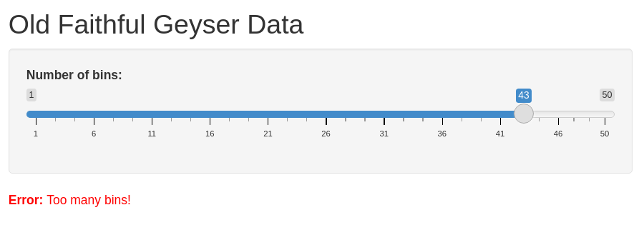
2) Shiny app with unhandled warning and error
# File: app.R
[... unchanged code omitted...]
server <- function(input, output) {
output$distPlot <- renderPlot({
# generate bins based on input$bins from ui.R
x <- faithful[, 2]
bins <- seq(min(x), max(x), length.out = input$bins + 1)
# some fancy logic
source("script_with_error.R", local = TRUE)
# draw the histogram with the specified number of bins
hist(x, breaks = bins, col = 'darkgray', [...]
})
}
> runApp()
Listening on http://127.0.0.1:5067
Warning in log(-1) : NaNs produced
[1] NaN
Warning: Error in eval: Too many bins!
173: stop
168: renderPlot [app.R#40]
166: func
126: drawPlot
112: <reactive:plotObj>
96: drawReactive
83: renderFunc
82: output$distPlot
1: runApp
Note: Errors are shown as “warning” in Shiny!
# File: script_with_error.R
if (input$bins > 40)
stop("Too many bins!")
print(log(-1)) # just provoke a warning for demo purposes

Slide 7
Observations regarding unhandled conditions*
Unhandled errors
stop the creation of the user interface (leaving an incomplete UI)
are catched and reported as “warning” (to avoid crashing the complete shiny app)
Unhandled conditions*
do almost never show the real line of code that produced the error
do not show the data (variables) that cause the unexpected condition
It is not easy to reproduce and analyze a bug to fix it!
*) “condition” is the general R term for errors, warnings, messages and other “exceptions” that are derived from the R super class condition

Slide 8
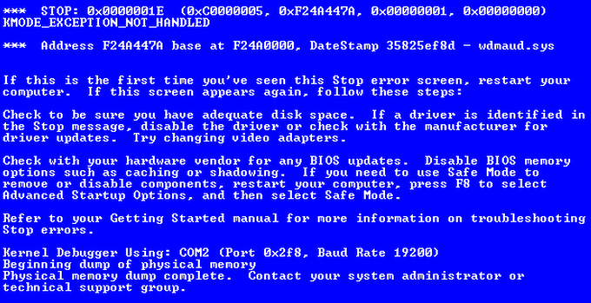
Approaches to hunt bugs
Logging (“tracing”, “auditing”)
print info about the current operation (code location + relevant data)
Interactive debugging
halt the code execution at chosen code locations
inspect the current state of variables
execute code (blocks) step-by-step
Post-mortem analysis
create a memory dump file of all objects incl. the call stack when an error occurs
inspect the objects along the call stack

Slide 9
3) Shiny app with logging and unhandled conditions
# File: app.R
[... unchanged code omitted...]
server <- function(input, output) {
library(futile.logger)
output$distPlot <- renderPlot({
flog.info("Begin of renderPlot (bins=%i)", input$bins)
# generate bins based on input$bins from ui.R
x <- faithful[, 2]
bins <- seq(min(x), max(x), length.out = input$bins + 1)
# some fancy logic
source("script_with_error.R", local = TRUE)
# draw the histogram with the specified number of bins
hist(x, breaks = bins, col = 'darkgray', [...]
flog.info("End of renderPlot")
})
}
> shiny::runApp()
INFO [2023-02-14 01:02:54] Begin of renderPlot
(bins=30)
Warning in log(-1) : NaNs produced
[1] NaN
INFO [2023-02-14 01:02:54] End of renderPlot
INFO [2023-02-14 01:04:05] Begin of renderPlot
(bins=43)
Warning: Error in eval: Too many bins!
173: stop
168: renderPlot [app.R#60]
126: drawPlot
112: <reactive:plotObj>
96: drawReactive
83: renderFunc
82: output$distPlot
1: shiny::runApp
# File: script_with_error.R
if (input$bins > 40)
stop("Too many bins!")
print(log(-1)) # just provoke a warning for demo purposes

Slide 10
Little detour: Which logging framework shall I use?
CRAN download statistics (of the last 30 days as of Feb 14, 2023) to indicate the popularity*:
package N downloads
[1: plogr 30 90222] → header-only C++ logging library (not for “plain” R)
2: futile.logger 30 72081
3: logger 30 22173
4: lgr 30 12827
5: logging 30 12707
6: debugme 30 8654
7: log4r 30 8025
8: logr 30 1434
9: loggit 30 693
The upcoming tryCatchLog release will support all major logging frameworks (not only futile.logger): https://github.com/aryoda/tryCatchLog/blob/feature/71_indiv_settings_per_condition_type/NEWS.md
*) see: https://github.com/aryoda/tryCatchLog/issues/42

Slide 11
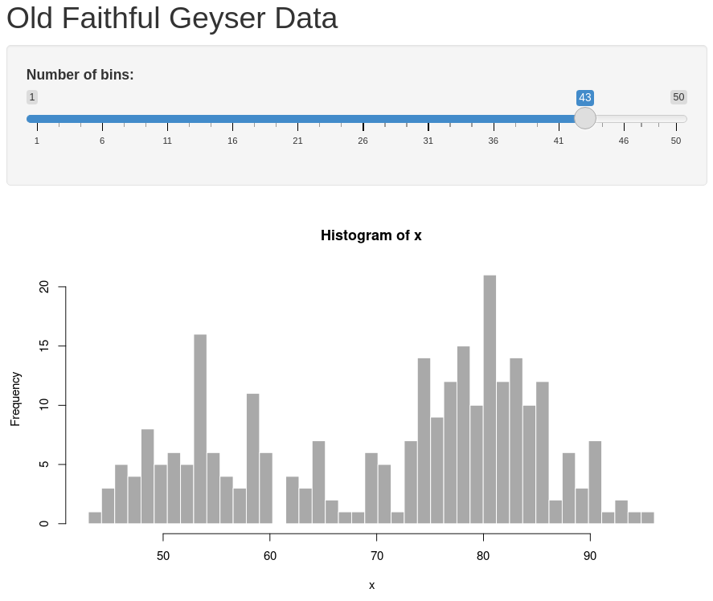
4) Shiny app with handled conditions
# File: app.R
[... unchanged code omitted...]
server <- function(input, output) {
library(futile.logger)
output$distPlot <- renderPlot({
flog.info("Begin of renderPlot (bins=%i)", input$bins)
# generate bins based on input$bins from ui.R
x <- faithful[, 2]
bins <- seq(min(x), max(x), length.out = input$bins + 1)
# some fancy logic
source("script_with_error_and_try.R", local = TRUE)
# draw the histogram with the specified number of bins
hist(x, breaks = bins, col = 'darkgray', [...]
flog.info("End of renderPlot")
[...]
> shiny::runApp()
INFO [2023-02-14 01:02:54] Begin of renderPlot
(bins=30)
Warning in log(-1) : NaNs produced
[1] NaN
INFO [2023-02-14 01:02:54] End of renderPlot
INFO [2023-02-14 01:02:54] Begin of renderPlot
(bins=43)
Error in try({ : Too many bins!
INFO [2023-02-14 01:02:54] End of renderPlot
# File: script_with_error_and_try.R
try({
if (input$bins > 40) {
stop("Too many bins!")
}
print(log(-1)) # just provoke a warning for demo purposes
})

Slide 12
5) Shiny app with tryCatch handler to print call stack
# File: app.R
[... unchanged code omitted...]
server <- function(input, output) {
library(futile.logger)
output$distPlot <- renderPlot({
flog.info("Begin of renderPlot (bins=%i)", input$bins)
# generate bins based on input$bins from ui.R
x <- faithful[, 2]
bins <- seq(min(x), max(x), length.out = input$bins + 1)
[...]
# File: script_with_error_and_tryCatch_and_callstack.R
tryCatch(
{
if (input$bins > 40) {
stop("Too many bins!")
}
print(log(-1)) # just provoke a warning for demo purposes
} , error = function(e) {
stack.trace <- paste(as.character(limitedLabels(tail(sys.calls(), 100))), collapse = "\n")
cat("Error occured: ", e$message, "\n") # error message
cat(stack.trace, "\n")
}
)
> shiny::runApp()
...
Error occured: Too many bins!
domain$wrapSync(expr)
withCallingHandlers(expr, error = doCaptureStack)
...
app.R#60: source("script_with_error_and_tryCatch...
...
eval(ei, envir)
script_with_error_and_tryCatch_and_callstack.R#1: tryCatch({ if (input$bins > 40) {

Slide 13
6) Shiny app with tryCatchLog handler
# File: app.R
[... unchanged code omitted...]
server <- function(input, output) {
library(futile.logger)
output$distPlot <- renderPlot({
flog.info("Begin of renderPlot (bins=%i)", input$bins)
# generate bins based on input$bins from ui.R
x <- faithful[, 2]
bins <- seq(min(x), max(x), length.out = input$bins + 1)
[...]
# File: script_with_error_and_tryLog.R
library(tryCatchLog)
options(keep.source = TRUE)
options(tryCatchLog.include.full.call.stack = FALSE)
tryLog(
{
if (input$bins > 40) {
stop("Too many bins!")
}
print(log(-1)) # just provoke a warning for demo purposes
}
)
> shiny::runApp()
...
ERROR [2023-02-14 02:22:24] Too many bins!
Compact call stack:
1 shiny::runApp()
2 app.R#57: source("script_with_error_and_tryLog.R"...
3 script_with_error_and_tryLog.R#9: tryLog({
4 tryLog.R#57: tryCatchLog(expr = expr, ...
5 tryCatchLog.R#476: tryCatch(...
6 tryCatchLog.R#476: withCallingHandlers(expr,...
7 script_with_error_and_tryLog.R#12: stop("Too many bins!")

Slide 14
7) Intro into dumps and post-mortem debugging
# File: dump_frames_intro.R
library(tryCatchLog)
x.global <- 99
f <- function(x) {
value <- x + 1
ff(value)
}
ff <- function(y) {
fff(y + 2)
}
fff <- function(z) {
print(paste("z =", z))
if(z > 4) stop("z is too big\n")
}
tryLog(f(2), write.error.dump.file = T, [...])
> debugger()
Message: z is too big
Available environments had calls:
1: source("dump_frames_intro.R")
2: withVisible(eval(ei, envir))
3: eval(ei, envir)
4: eval(ei, envir)
5: dump_frames_intro.R#25: tryLog(f(2), ...
6: tryLog.R#57: tryCatchLog(expr = expr, ...
7: tryCatchLog.R#476: tryCatch(withCallingHandlers(expr, ...
8: tryCatchList(expr, classes, parentenv, handlers)
9: tryCatchOne(expr, names, parentenv, handlers[[1]])
10: doTryCatch(return(expr), name, parentenv, handler)
11: tryCatchLog.R#476: withCallingHandlers(expr, ...
12: tryLog.R#57: f(2)
13: dump_frames_intro.R#9: ff(value)
14: dump_frames_intro.R#13: fff(y + 2)
15: dump_frames_intro.R#18: stop("z is too big\n")
16: .handleSimpleError(function (c)
{
write.to.log <- TRUE
log.as.severity <- NA
config.check.result <- is.
17: h(simpleError(msg, call))
Enter an environment number, or 0 to exit
Selection:
# File: post_mortem_analysis.R
# --- Reset workspace before debugging
# See `?dump.frames` and `?debugger` for details
load("dump.rda") # use an already prepared dump
debugger()

Slide 15
Post-mortem debugging: Inspect variables
# File: dump_frames_intro.R
library(tryCatchLog)
x.global <- 99
f <- function(x) {
value <- x + 1
ff(value)
}
ff <- function(y) {
fff(y + 2)
}
fff <- function(z) {
print(paste("z =", z))
if(z > 4) stop("z is too big\n")
}
tryLog(f(2), write.error.dump.file = T, [...])
Enter an environment number, or 0 to exit
Selection: 4
Browsing in the environment with call:
eval(ei, envir)
Called from: debugger.look(ind)
Browse[1]> ls()
[1] "f" "ff" "fff" "last.dump" "x.global"
Browse[1]> x.global
[1] 99
Browse[1]> x.global <- 22
Browse[1]> x.global
[1] 22
Browse[1]>
Available environments had calls:
...
4: eval(ei, envir)
5: dump_frames_intro.R#25: tryLog(f(2), ...
...
13: dump_frames_intro.R#9: ff(value)
14: dump_frames_intro.R#13: fff(y + 2)
15: dump_frames_intro.R#18: stop("z is too big\n")
...
Enter an environment number, or 0 to exit
Selection:
use the parent call number (!) to look into variables visible at the call code location
list directly visible variables
show the value of a variable
change the value of a variable
press ENTER to leave the browser (“debugger”) and go back to the call selection
# File: post_mortem_analysis.R
# --- Reset workspace before debugging
# See `?dump.frames` and `?debugger` for details
load("dump.rda") # use an already prepared dump
debugger()

Slide 16
Post-mortem debugging: Hunt down the bug
# File: dump_frames_intro.R
library(tryCatchLog)
x.global <- 99
f <- function(x) {
value <- x + 1
ff(value)
}
ff <- function(y) {
fff(y + 2)
}
fff <- function(z) {
print(paste("z =", z))
if(z > 4) stop("z is too big\n")
}
tryLog(f(2), write.error.dump.file = T, [...])
Available environments had calls:
...
4: eval(ei, envir)
5: dump_frames_intro.R#25: tryLog(f(2), ...
...
13: dump_frames_intro.R#9: ff(value)
14: dump_frames_intro.R#13: fff(y + 2)
15: dump_frames_intro.R#18: stop("z is too big\n")
...
Enter an environment number, or 0 to exit
Selection: 14
Browsing in the environment with call:
dump_frames_intro.R#13: fff(y + 2)
Called from: debugger.look(ind)
Browse[1]> ls()
[1] "z"
Browse[1]> z
[1] 5
Browse[1]> z > 4
[1] TRUE
Browse[1]>
Determine the frame causing the error by entering the call frame (call number minus one!) and checking the variables...
# File: post_mortem_analysis.R
# --- Reset workspace before debugging
# See `?dump.frames` and `?debugger` for details
load("dump.rda") # use an already prepared dump
debugger()

Slide 17
Little detour: Environment, frames and (en)closures
See: ?environment:
Environments consist of - a frame (collection of named objects) - and a pointer to an enclosing environment. Example: Frame of variables local to a function call. Its enclosure is the environment where the function was defined.
The enclosing environment is distinguished from the parent frame: the latter (returned by parent.frame) refers to the environment of the caller of a function.
Since confusion is so easy, it is best never to use ‘parent’ in connection with an environment (despite the presence of the function parent.env).
Confused? ;-)

Slide 18
8) Post-mortem debugging of a shiny app
# File: app.R
[...]
server <- function(input, output) {
library(futile.logger)
output$distPlot <- renderPlot({
flog.info("Begin of renderPlot (bins=%i)",
input$bins)
# generate bins based on input$bins
x <- faithful[, 2]
bins <- seq(min(x), max(x), length.out =
input$bins + 1)
[...]
> load("dump.rda")
> debugger(last.dump)
166: func()
167: ..stacktraceon..(renderPlot())
168: renderPlot()
169: app.R#60: source("script_with_error_and_tryLog_and_dump
...
173: script_with_error_and_tryLog_and_dump_file.R#12: tryLog({
if (input$bins > 40) {
stop("Too many bins!")
174: tryLog.R#57: tryCatchLog(expr = expr...
...
180: script_with_error_and_tryLog_and_dump_file.R#15:
stop("Too many bins!")
...
Enter an environment number, or 0 to exit
Selection: 172
Browsing in the environment with call:
eval(ei, envir)
Called from: debugger.look(ind)
Browse[1]> ls()
[1] "bins" "x"
# File: script_with_error_and_tryLog_and_dump_file.R
library(tryCatchLog)
options("tryCatchLog.write.error.dump.file" = TRUE)
options(tryCatchLog.include.full.call.stack = FALSE)
tryLog( {
if (input$bins > 40) {
stop("Too many bins!")
}
print(log(-1)) # just provoke a warning
})
Oops, where is the “input” variable? => “input” is a “reactiveValues”
class (an “environment”) and shiny hides it quite well.
Best practice: Always use a local variable to store the required
variables of “input” (or “output”) to ease post-mortem analysis!

Slide 19
When to use which approach to hunt bugs?
 | Logging | Debugging | Post-mortem analysis
Preparation efforts | High: Logging functions must be added into code first | Low: No code changes required normally | Medium: Each reactive function requires at least one “error handler”
Available during DEV vs when deployed on shiny server (e.g. PRD ;-) | Local machine + server | local machine only (R does not support remote debugging of processes) | Local machine + server
Advantages | Logging granularity can be modified without changing code Always active when something happens | step-by-step code execution interactive examination of (large) data no code changes required | Sporadic (non-reproducible) bugs can be analyzed (killer feature ;-) Debugging is not possible (e.g. on a production remote machine) Captures exact code location and call stack of an error Allows interactive examination of (large) data
Restrictions | Logging of larger data like data frames not practical Code without logging calls is a black box Requires code changes and possibly a roll-out if adding/modifying logging calls are required to hunt a bug possible performance overhead risk of introducing a bug (e.g. RTE) in a logging call | No remote debugging on the server (e.g. if a bug happens only on a certain infrastructure) Non-reproducible bugs are difficult to discover | no (easy) step-by-step code execution (“debugging”) memory dumps may flood the server HDD/SSD until it is full ;-) “input” and “output” variables of the server() function are not visible (should therefor be stored in a local variable before using it)

Slide 20
Summary: Steps to enable logging and post-mortem
Use the packages tryCatchLog and a logging framework like futile.logger
Set global options for tryCatchLog and your logging framework in your app.R
Surround every reactive function with a tryLog() block (which also catches conditions in all called functions within the block)
Optionally: Add try/tryCatch/tryLog/tryCatchLog condition handler arround every expression where you want to handle expected conditions in a special way (ignore, retry, graceful recovery…)
Optionally: Add INFO or DEBUG severity logging output calls with relevant variables at the beginning and end of each of your functions (and other significant code locations)
Store required input and output objects in local variables to make them visible in dump files for post-mortem analysis
# app.R
library(shiny)
library(tryCatchLog)
library(futile.logger) # “flog”
flog.threshold(INFO) # or FATAL, ERROR, WARN, INFO
# flog.appender(appender.file("my_app.log"))
# Keep the file name and line numbers of sourced files
options(keep.source = TRUE)
# creates a dump file for each error
options(tryCatchLog.write.error.dump.file = TRUE)
# stack trace shall contain only code with known line numbers
options(tryCatchLog.include.full.call.stack = FALSE)
[…]
output$distPlot <- renderPlot({
tryLog({
flog.info("Begin of renderPlot (bins=%i)", input$bins)
bins <- input$bins
[…]
flog.info("End of renderPlot")
})
})

Slide 21
Questions?

Slide 22
Links
Slides: https://github.com/aryoda/R_shiny_post_mortem_analysis_training
tryCatchLog package: https://github.com/aryoda/tryCatchLog
Excellent shiny intro: https://debruine.github.io/shinyintro
Debugging shiny applications (official doc): https://shiny.rstudio.com/articles/debugging.html
List of shiny options: https://shiny.rstudio.com/reference/shiny/latest/shinyoptions
Debugging hints: https://stackoverflow.com/questions/31920286/effectively-debugging-shiny-apps https://stackoverflow.com/questions/32222935/find-source-of-warning-in-shiny-app

Slide 23
Things not mentioned but worth to do it...
Shiny Server trace output will be placed in a log file on the server under: /var/log/shiny-server/*.log
options(shiny.fullstacktrace = TRUE) # see also shiny-internal calls!
...

